Slide 1
Deep Learning

Slide 2
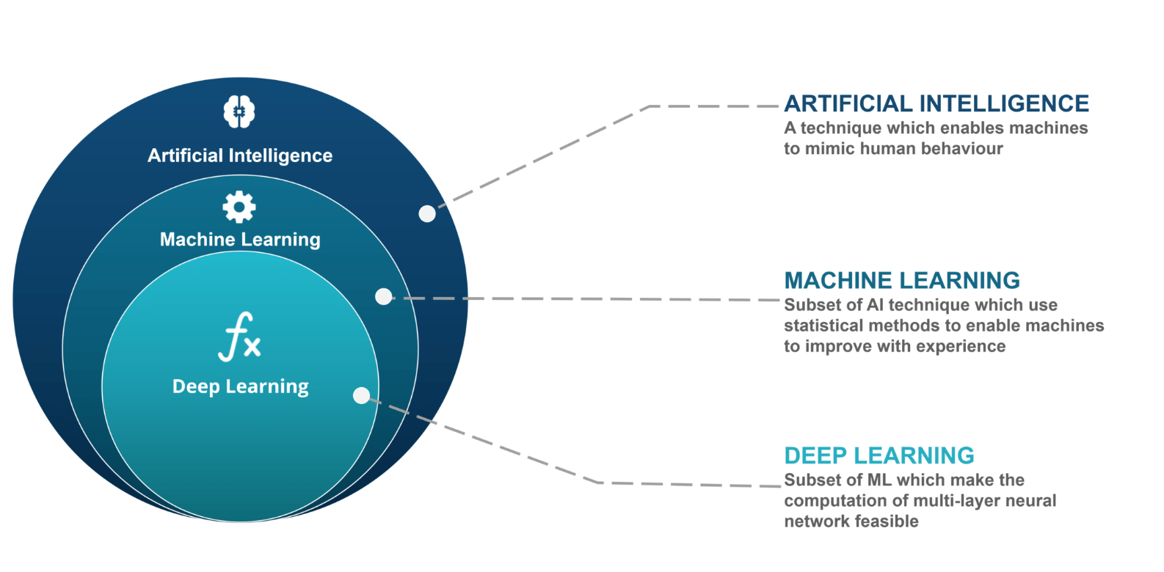

Slide 3

Deep Learning Frameworks

Slide 4
Agenda
Introduction
Forward Propagation
Gradient Descent
Back Propagation of Errors
Checking Gradient
Training via BFGS
Overfitting and Regularization

Slide 5

Introduction
Artificial Neural network is a class of Machine learning model, made up of several interconnected neurons, organized in layers which exchanges messages when certain condition happens.
we used a gradient descent optimization algorithm to learn the weight coefficients of the model. In every pass, we updated the weight vector ww using the following update rule:

Slide 6
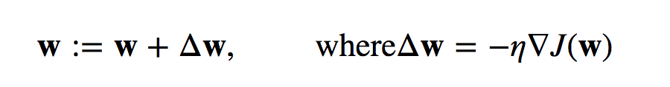
Introduction
we implemented an algorithm to perform binary classification, and we used a gradient descent optimization algorithm to learn the weight coefficients of the model. In every pass, we updated the weight vector ww using the following update rule:
We computed the gradient based on the whole training set and updated the weights of the model by taking a step into the opposite direction of the gradient ∇J(w)∇J(w).

Slide 7
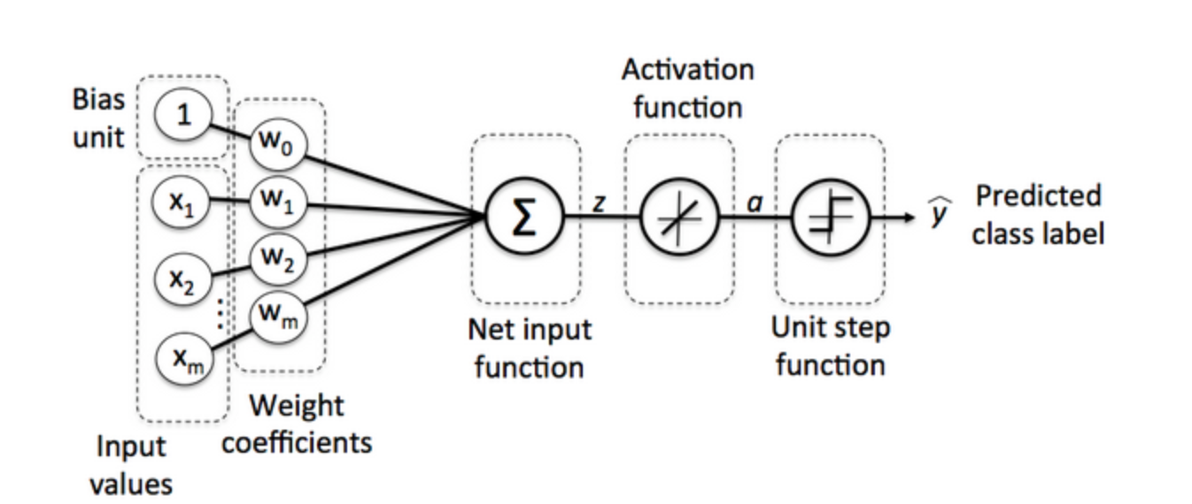
We optimized the cost function J(w)J(w) which is multiplied the gradient by the learning rate ηη. The rate is chosen carefully to balance the speed of learning against the risk of overshooting the global minimum of the cost function.

Slide 8
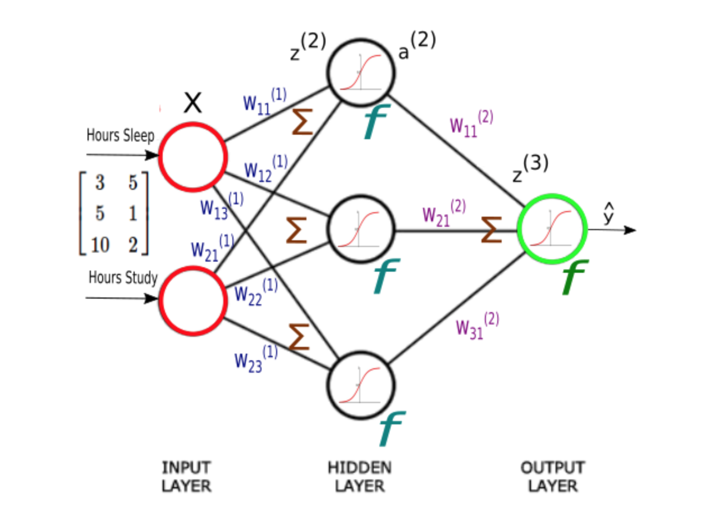
Forward Propagation
Each input value in matrix XX should be multiplied by a corresponding weight and then added together with all the other results for each neuron.

Slide 9
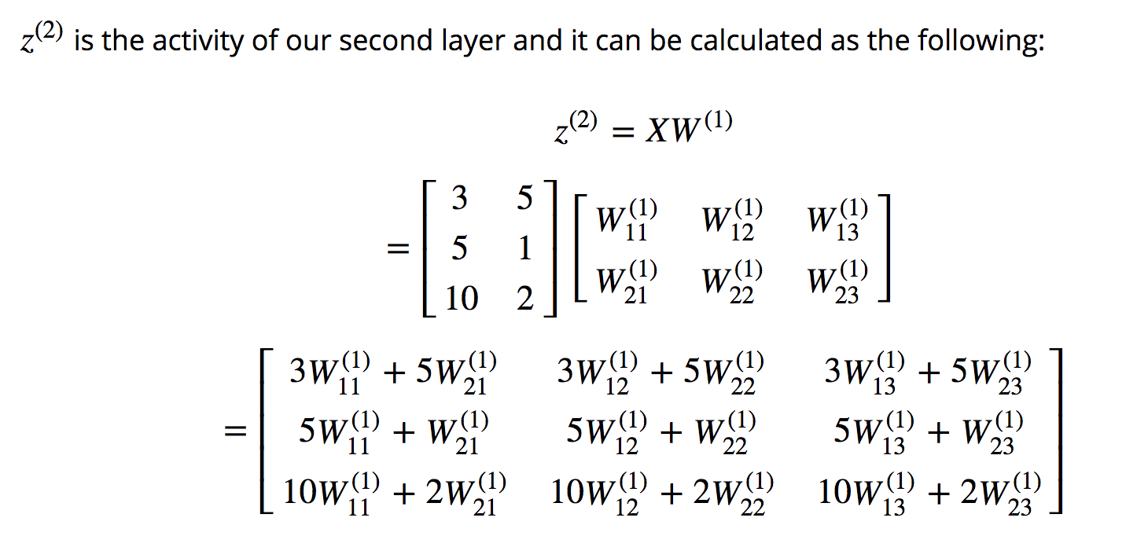
Forward Propagation

Slide 10
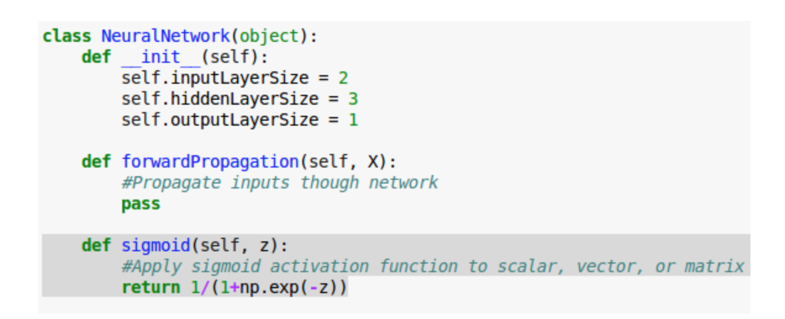
Activation Function
We will Independently apply the sigmoid function to each matrix in matrix z

Slide 11
Activation Function

Slide 12
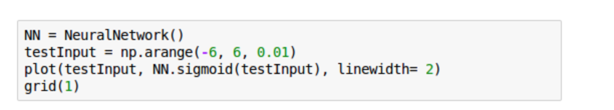
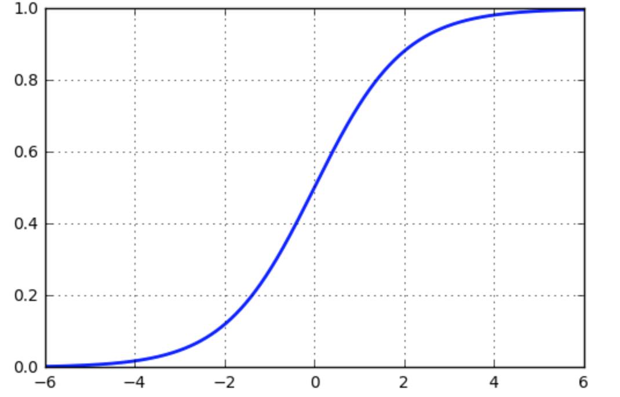
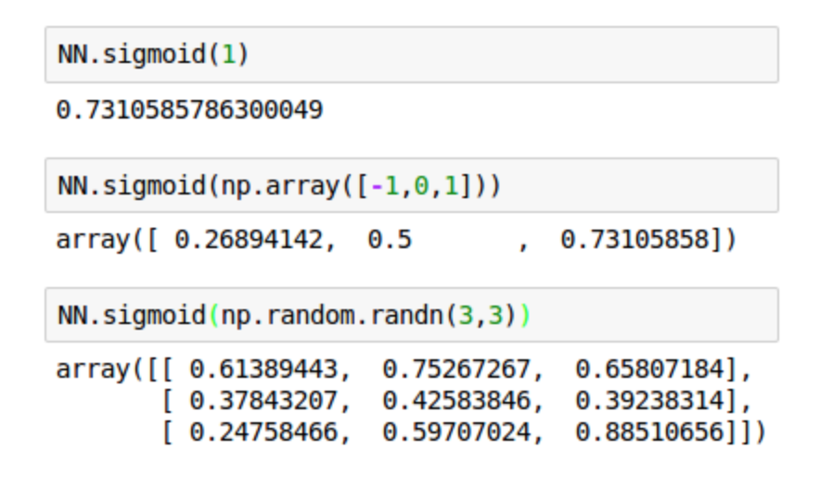
Activation Function
By using numpy we'll apply the activation function element-wise, and return a result of the same dimension as it was given:
The following calls for the sigmoid() with args : a number (scalar), 1-D (vector), and 2-D arrays (matrix).

Slide 13
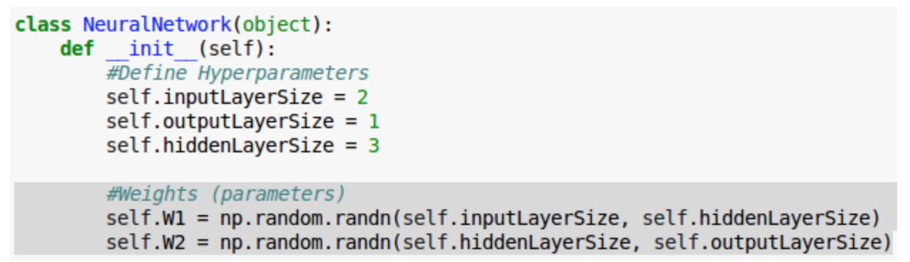
Weight Matrices
We Initialize the weight matrices in our __init__ method with random numbers

Slide 14
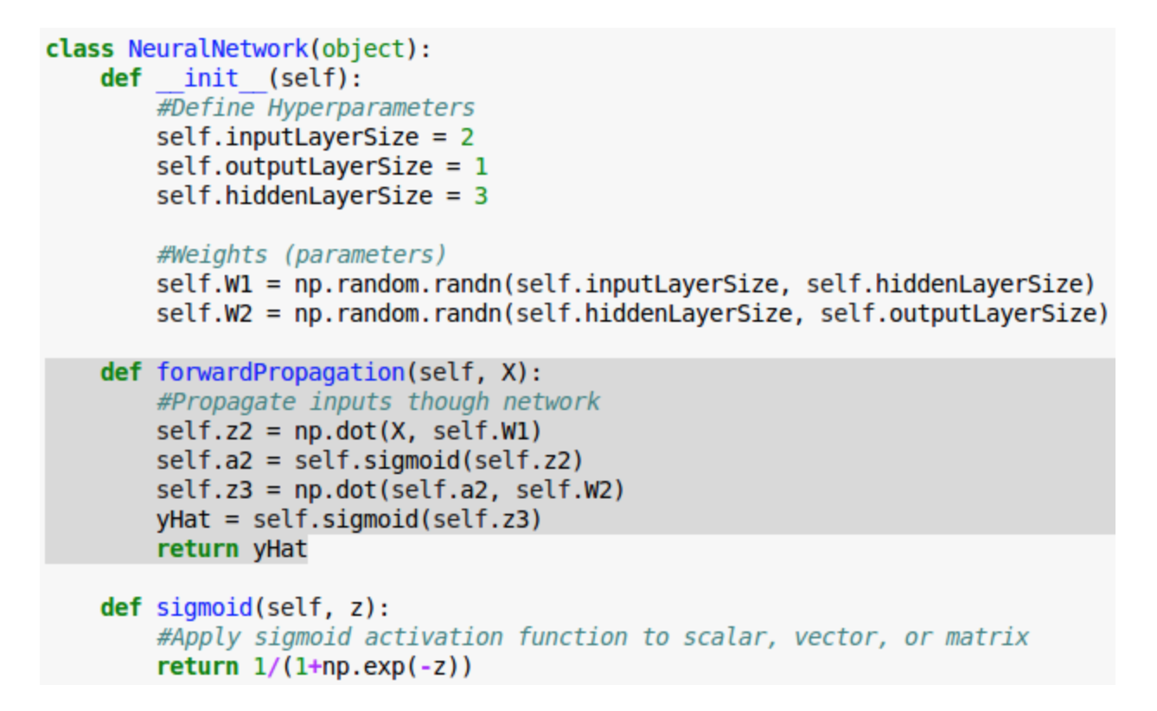
Forward Propagation
Forward propagation method using numpy’s built in dot method for matrix multiplication

Slide 15
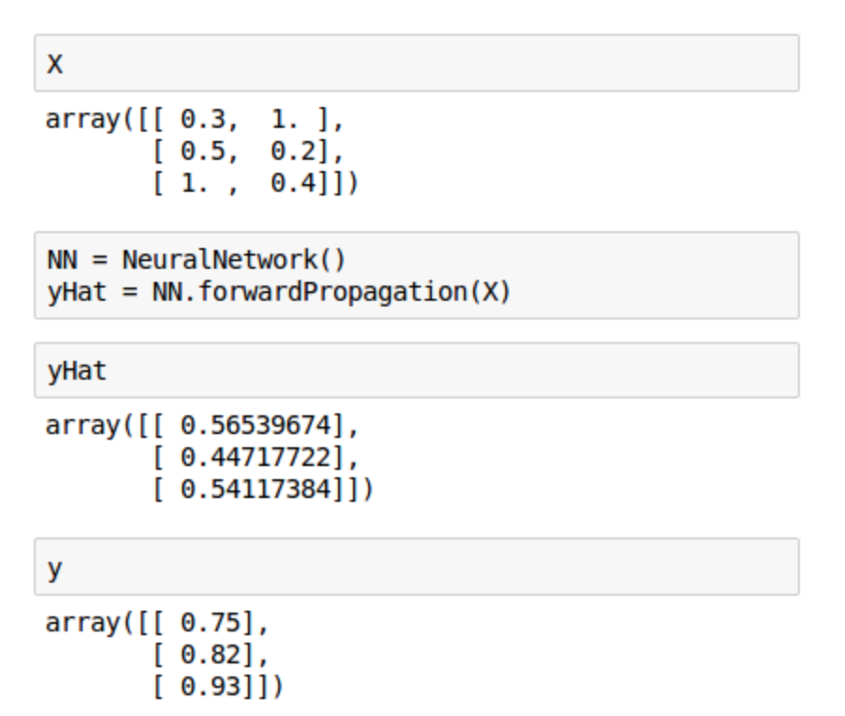
Getting Estimate of Test Score
Now we have a class capable of estimating our test score given how many hours we sleep and how many hours we study. We pass in our input data (X) and get real outputs
Note that our estimates (ŷ) looks quite terrible when compared with our target (y). That's because we have not yet trained our network

Slide 16
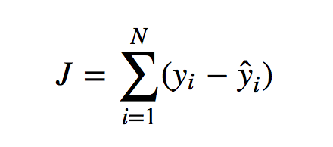
Back propagation
For a given sample, a cost function tells us how costly our model is. It exactly quantify how wrong our predictions are
We'll use sum of square errors to compute an overall cost and we'll try to minimize it. Actually, training a network means minimizing a cost function.

Slide 17
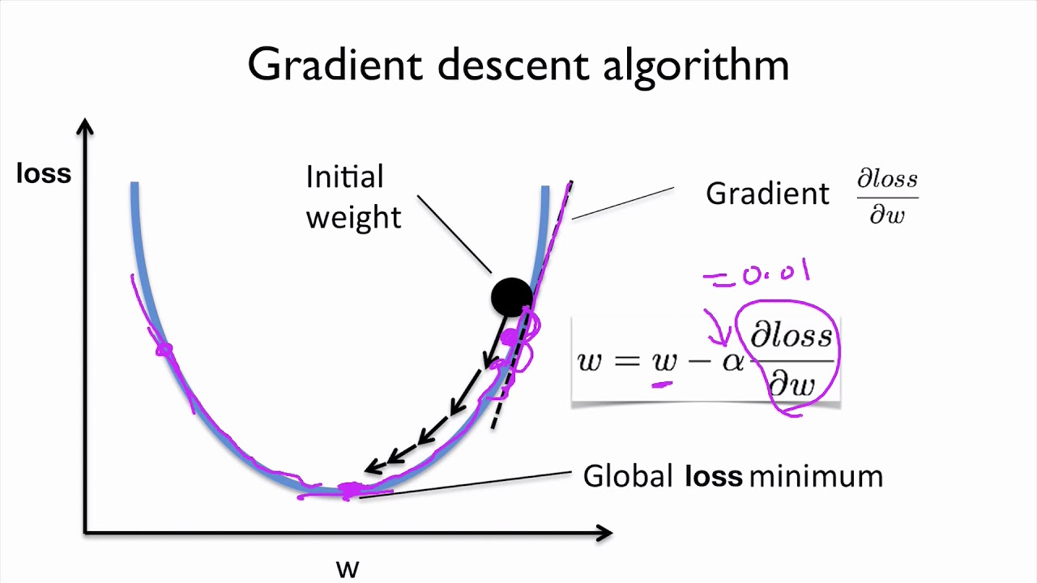
Gradient Descent
As we can see from equation, the cost is a function of two things: our sample data and the weights on our synapses. Since we don't have much control of our data, we'll try to minimize our cost by changing the weights.

Slide 18
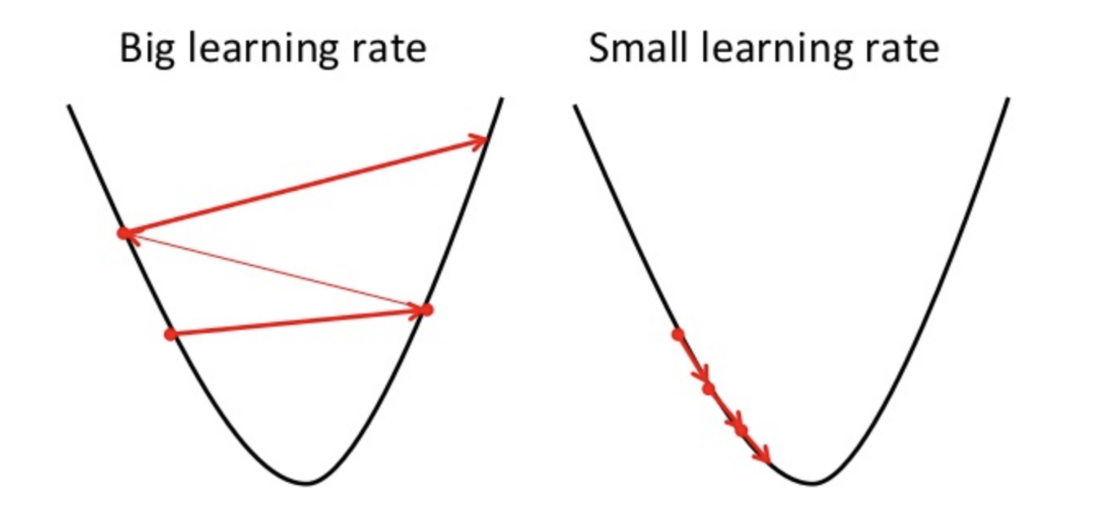
Small Learning Rate vs Big

Slide 19
Types of Gradient Descent Algorithm
Batch Gradient Descent
Mini Batch Gradient Descent
Stochastic Gradient Descent

Slide 20
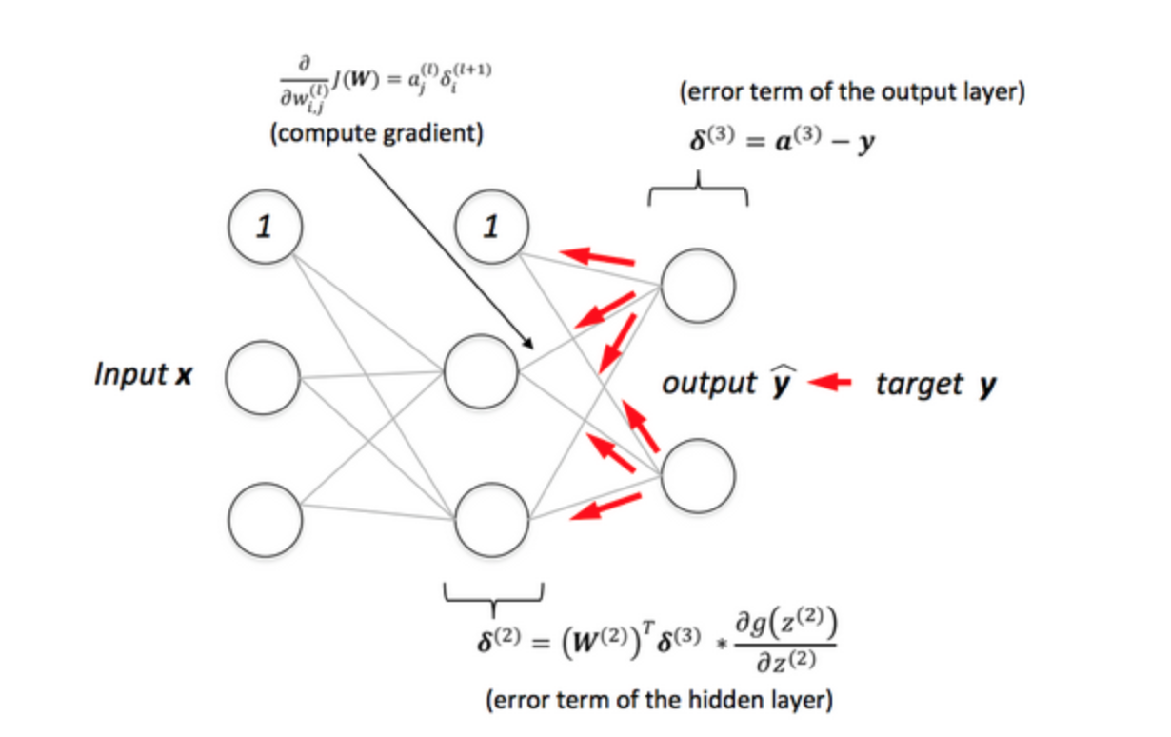
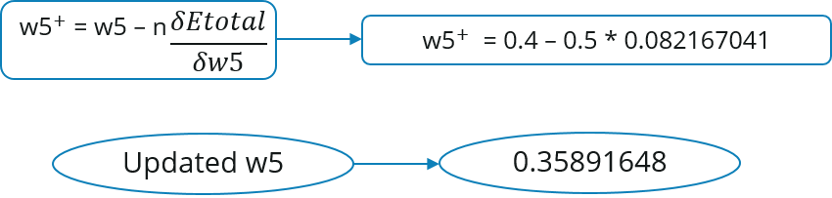
Back Propagation
Backpropagation (Backward propagation of errors) algorithm is used to train artificial neural networks, it can update the weights very efficiently.

Slide 21

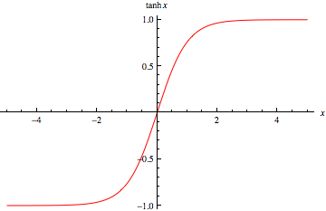

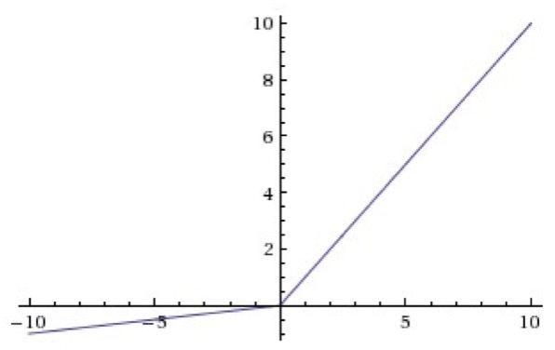
Activation Function
Softmax
LeakyRelu

Slide 22
Convolutional Neural Network(CNN)

Slide 23
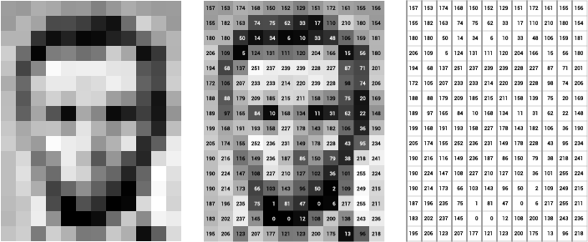
A Image is a combination of pixel
-A pixel is a smallest unit of representation for visual information
-Each pixel in a digitized image represents one intensity(brightness) level (gray scale color)
-The Brightness levels are between 0 to 255(0 - black and 255 white)

Slide 24
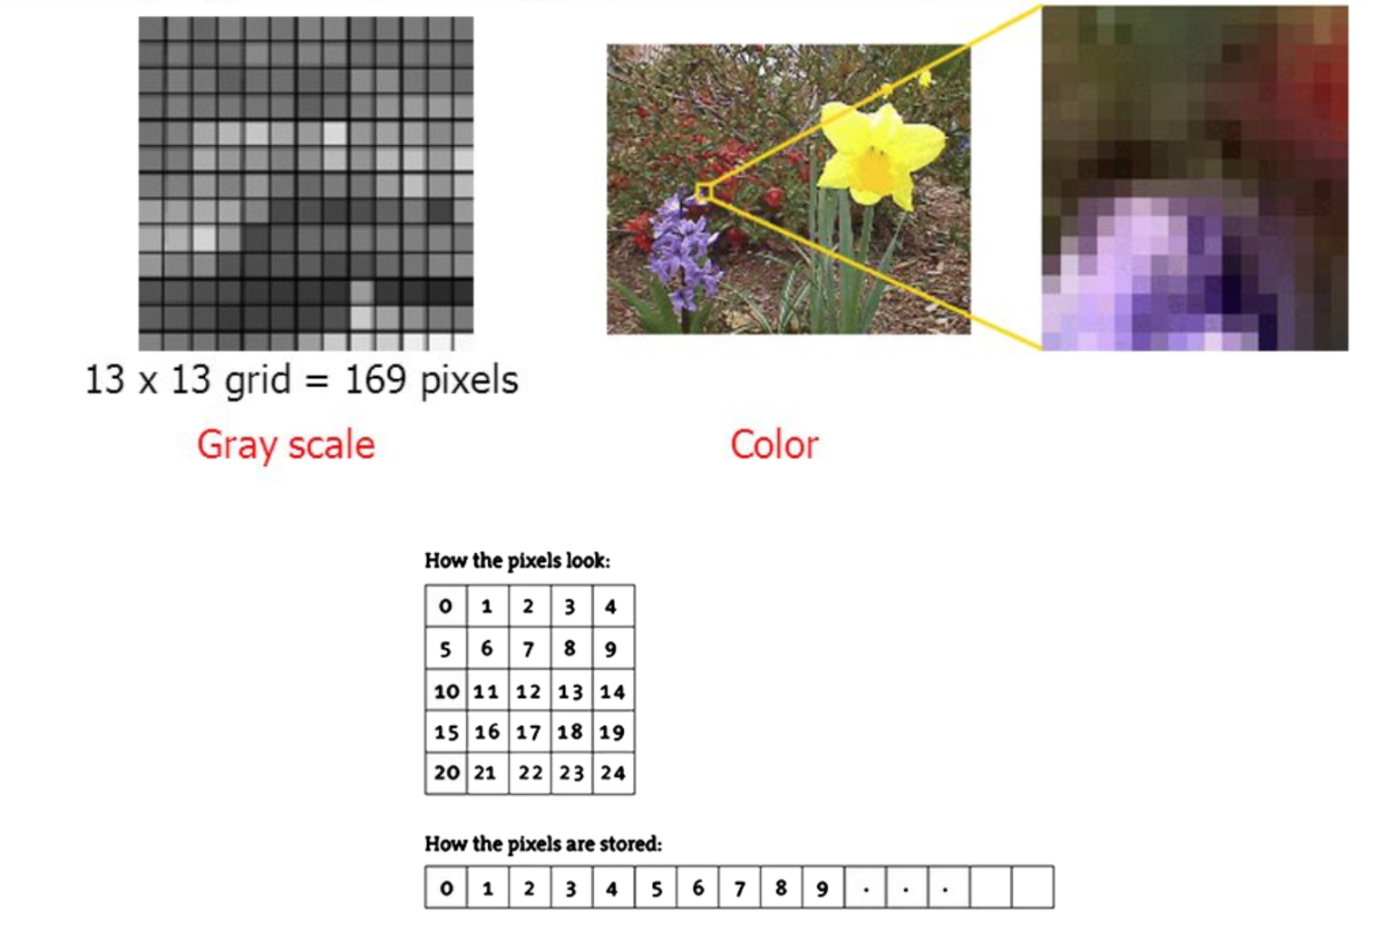
A Image is a combination of pixel
-A pixel is a sallest unit of representation for visual information
-Each pixel in a digitized image represents one intensity(brightness) level (gray scale color)
-The Brightness levels are between 0 to 255(0 - black and 255 white)

Slide 25
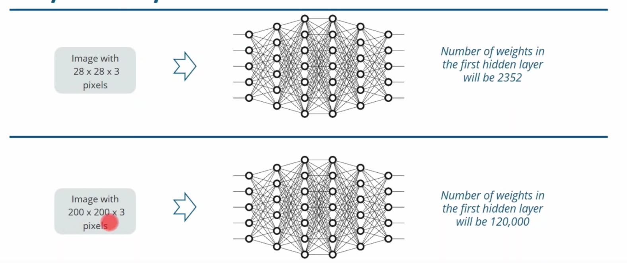
Why not Fully Connected Neural Network

Slide 26
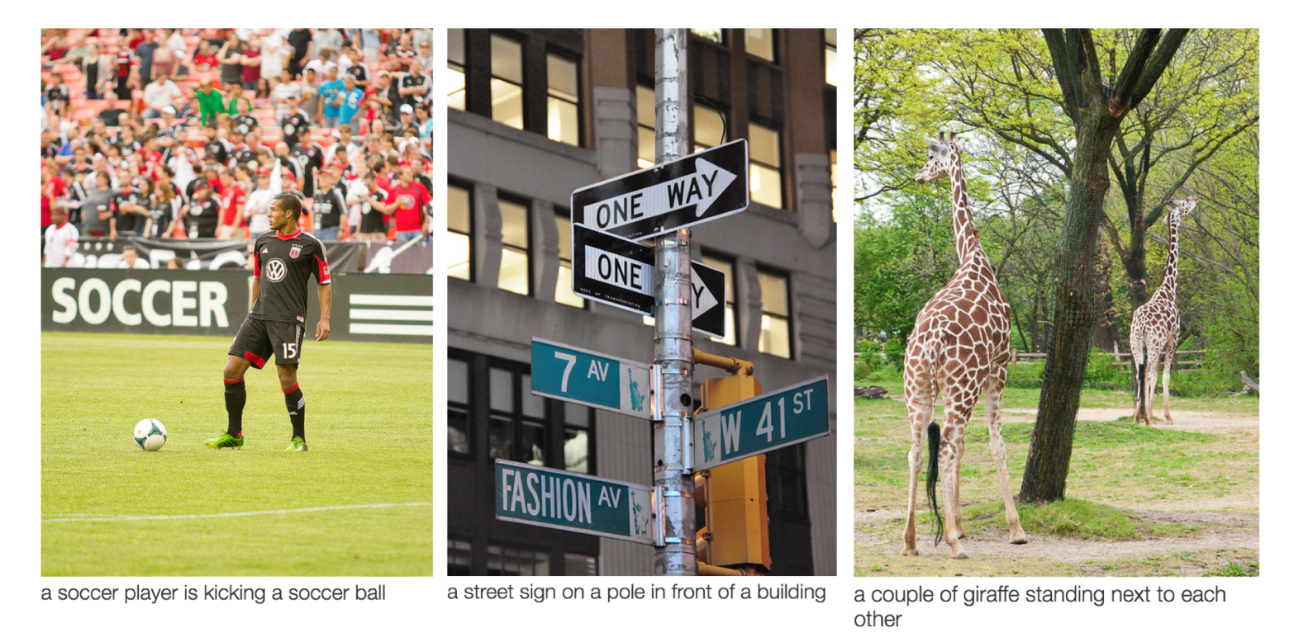
Convolutional Neural Networks (ConvNets or CNNs) are a category of Neural Networks that have proven very effective in areas such as image recognition and classification.

Slide 27
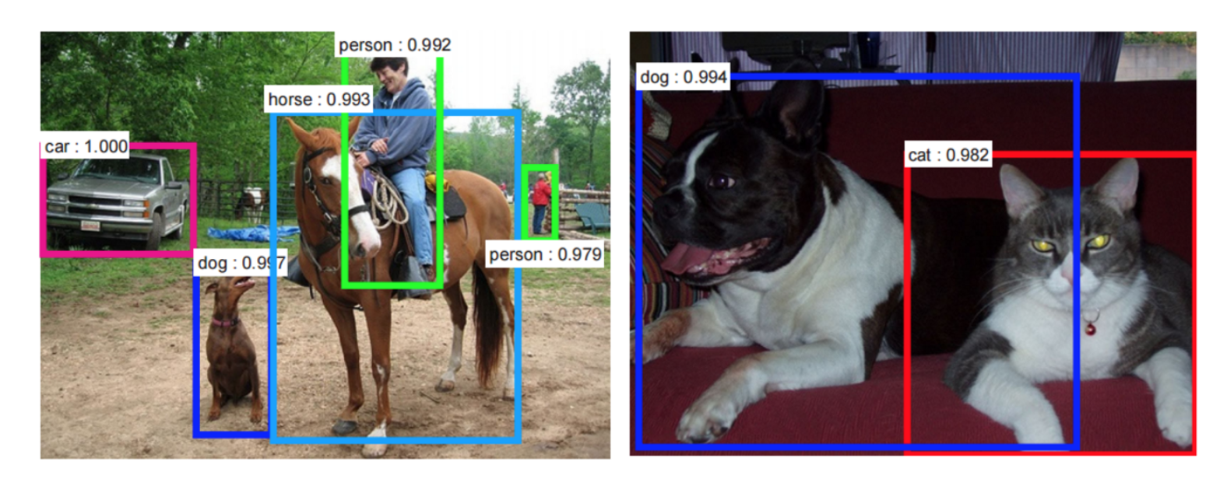
ConvNets being used for recognizing everyday objects, humans and animals.

Slide 28

Convolutional Neural Network
Convolutional Neural Network based on the following principles
Local Receptive Field
Shared Weights
Pooling or Down Sampling

Slide 29
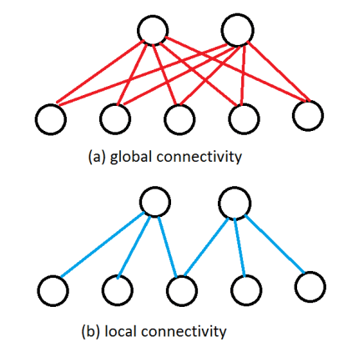
Local Connectivity

Slide 30

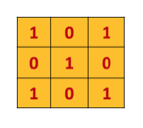
Convolutional Filter
Convolution extracts features from the input image
Convolution preserves the spatial relationship between pixels by learning image features using small squares of input data

Slide 31
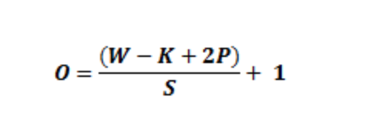
Shared Weights
In this Local Receptive field, Convolutional Neural Networks use the same shared weights, for each of the hidden neurons.
This means that we have great advantage of Parameter reduction, for instance for a 5x5 receptive field, we’ll need only 25 receptive fields
20 Feature maps using 5x5 -- 20*26 = 520 weights
A fully connected first layer with 784 = 28 * 28 input neurons, and relatively modest 30 hidden neurons, would produce 784*30=23,520 weights. More than 40 times as many parameters as the convolutional layer
For example, if we take S=1, P=2 with W=2000 and K=5 and using 40 filters, then the output size will 200×200×40200×200×40 using the above formula.

Slide 32
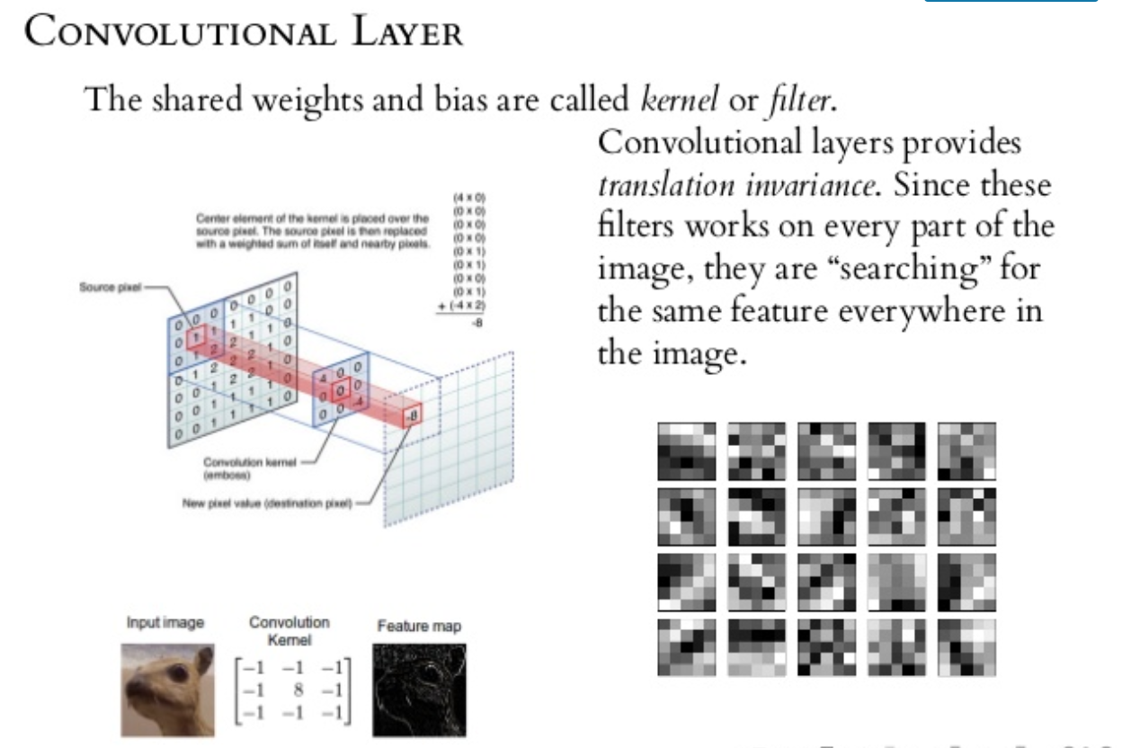

Slide 33
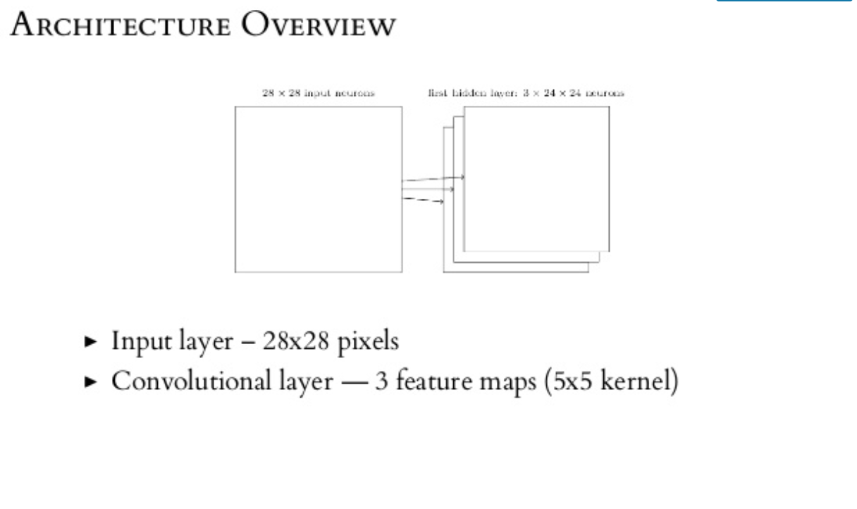


Slide 34
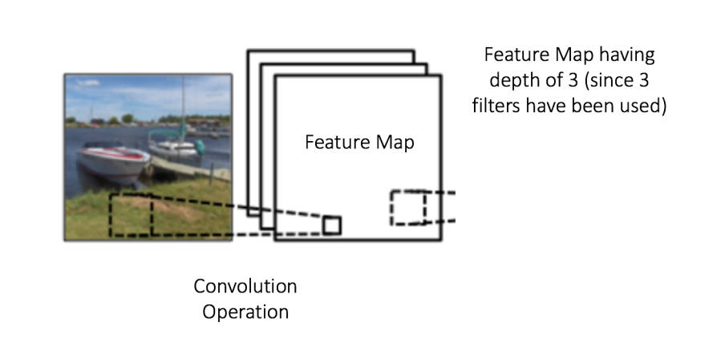
Parameters
Depth: Depth corresponds to the number of filters we use for the convolution operation
Stride: Stride is the number of pixels by which we slide our filter matrix over the input matrix. When the stride is 1 then we move the filters one pixel at a time. When the stride is 2, then the filters jump 2 pixels at a time as we slide them around. Having a larger stride will produce smaller feature maps.

Slide 35
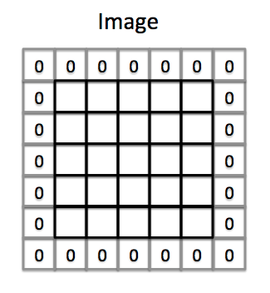
Parameters
Zero-padding: Sometimes, it is convenient to pad the input matrix with zeros around the border, so that we can apply the filter to bordering elements of our input image matrix.
A nice feature of zero padding is that it allows us to control the size of the feature maps.
Adding zero-padding is also called wide convolution, and not using zero-padding would be a narrow convolution

Slide 36
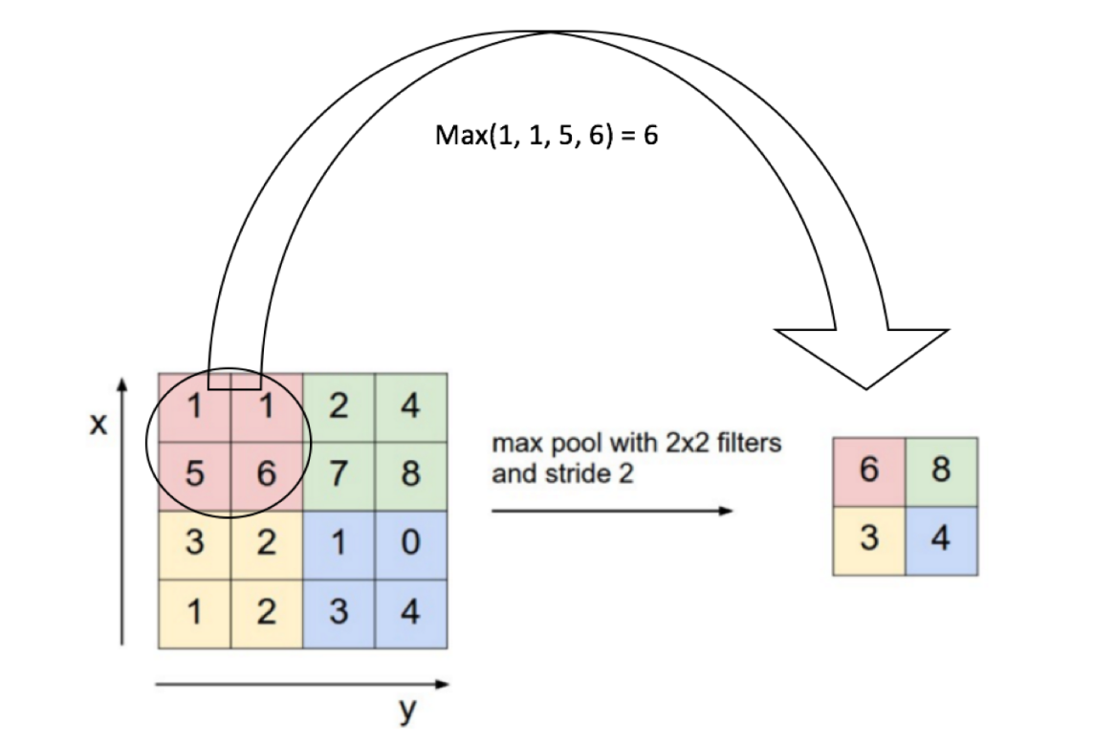
The Pooling Step
Spatial Pooling (also called subsampling or downsampling) reduces the dimensionality of each feature map but retains the most important information. Spatial Pooling can be of different types: Max, Average, Sum etc.
In case of Max Pooling, we define a spatial neighborhood (for example, a 2×2 window) and take the largest element from the rectified feature map within that window. Instead of taking the largest element we could also take the average (Average Pooling) or sum of all elements in that window. In practice, Max Pooling has been shown to work better.

Slide 37
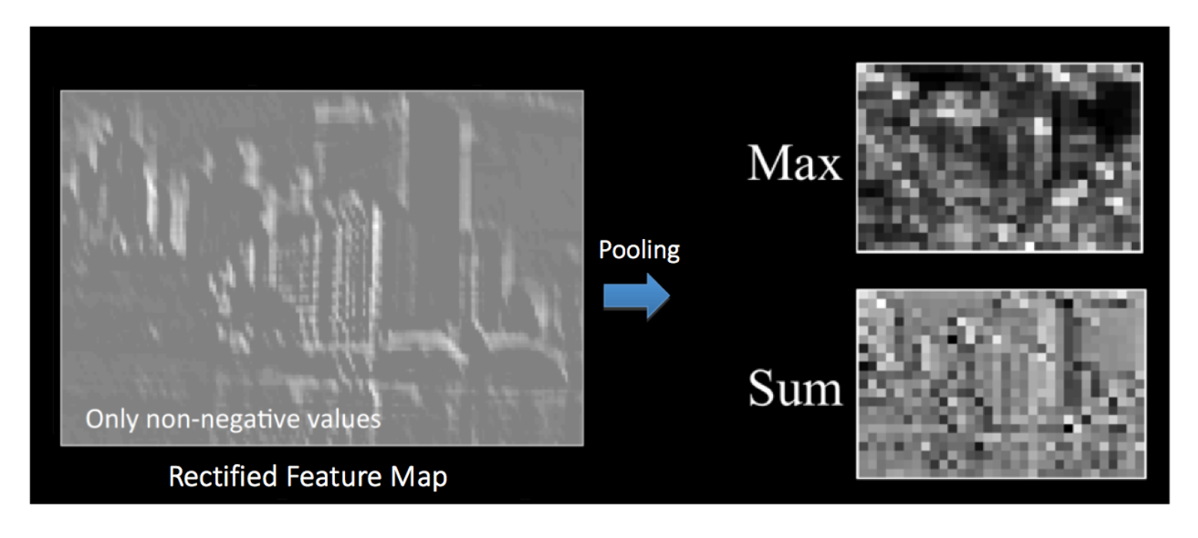
The effect of Pooling on the Rectified Feature Map we received after the ReLU operation

Slide 38
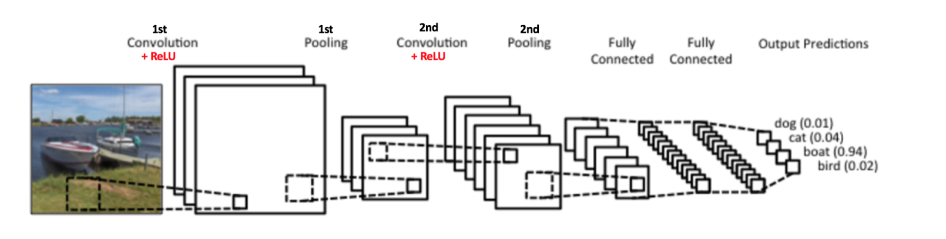
Complete Architecture

Slide 39
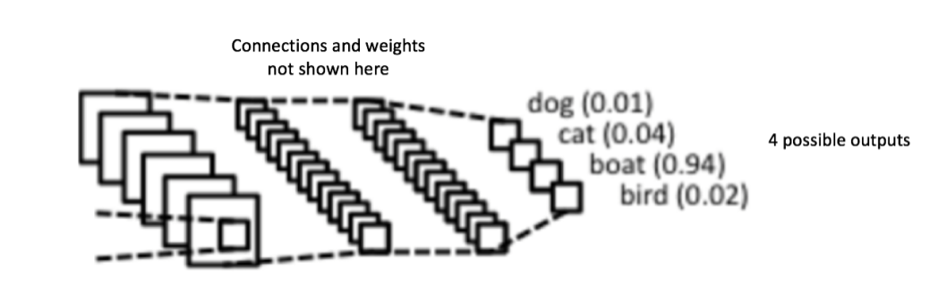
Fully Connected Layer
The Fully Connected layer is a traditional Multi Layer Perceptron that uses a softmax activation function in the output layer
The term “Fully Connected” implies that every neuron in the previous layer is connected to every neuron on the next layer
The output from the convolutional and pooling layers represent high-level features of the input image. The purpose of the Fully Connected layer is to use these features for classifying the input image into various classes based on the training dataset

Slide 40
https://www.saama.com/blog/different-kinds-convolutional-filters/
Putting it all together
Step1: We initialize all filters and parameters / weights with random values
Step2: The network takes a training image as input, goes through the forward propagation step (convolution, ReLU and pooling operations along with forward propagation in the Fully Connected layer) and finds the output probabilities for each class.
Lets say the output probabilities for the boat image above are [0.2, 0.4, 0.1, 0.3]
Since weights are randomly assigned for the first training example, output probabilities are also random.
Step3: Calculate the total error at the output layer (summation over all 4 classes)
Total Error = ∑ ½ (target probability – output probability) ²
Step4: Use Backpropagation to calculate the gradients of the error with respect to all weights in the network and use gradient descent to update all filter values / weights and parameter values to minimize the output error.
The weights are adjusted in proportion to their contribution to the total error.
When the same image is input again, output probabilities might now be [0.1, 0.1, 0.7, 0.1], which is closer to the target vector [0, 0, 1, 0].
This means that the network has learnt to classify this particular image correctly by adjusting its weights / filters such that the output error is reduced.
Parameters like number of filters, filter sizes, architecture of the network etc. have all been fixed before Step 1 and do not change during training process – only the values of the filter matrix and connection weights get updated.
Step5: Repeat steps 2-4 with all images in the training set.

Slide 41
Recurrent Neural Network

Slide 42
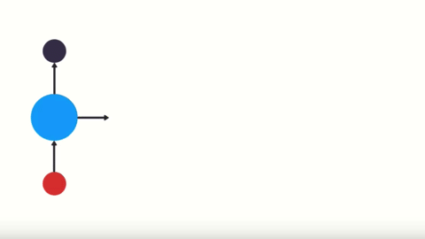
Recurrent Neural Networks are the state of the art algorithm for sequential data and among others used by Apples Siri and Googles Voice Search
This is because it is the first algorithm that remembers its input, due to an internal memory

Slide 43
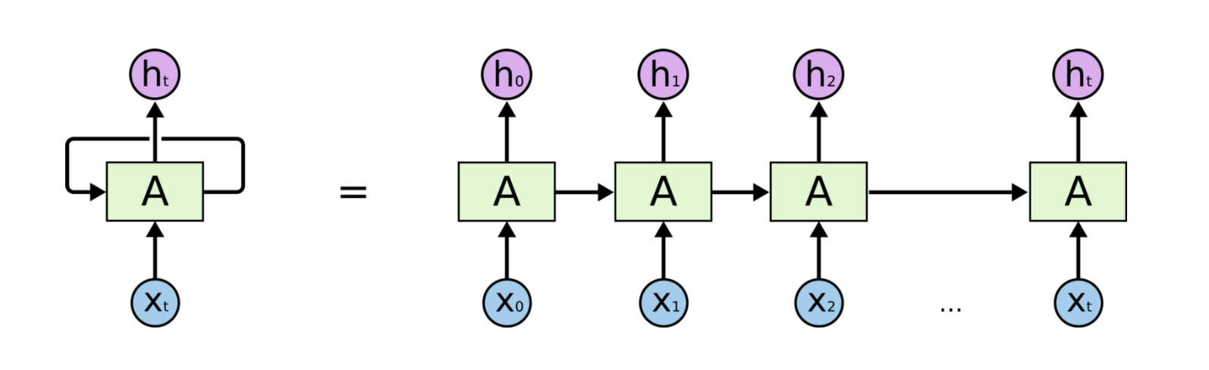
What is RNN
Basic RNNs are a network of neuron-like nodes organized into successive "layers", each node in a given layer is connected with a directed (one-way) connection to every other node in the next successive layer
Input Nodes
Hidden Nodes
Output Nodes

Slide 44
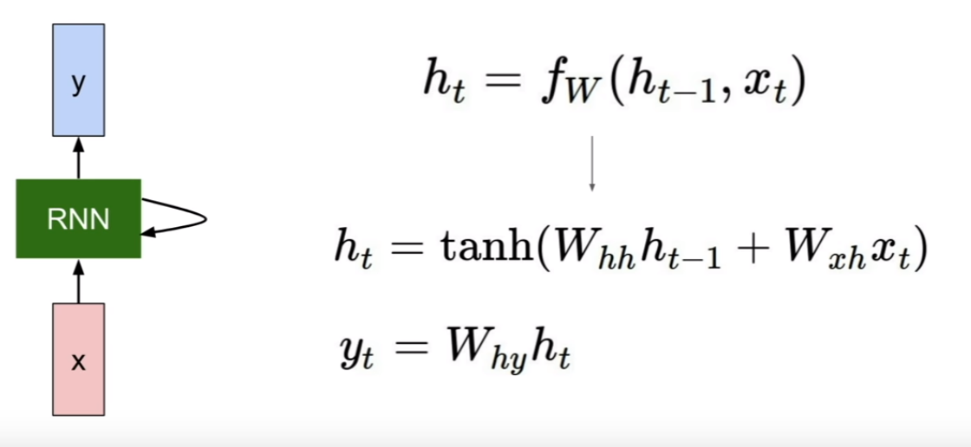
RNN Mechanics

Slide 45
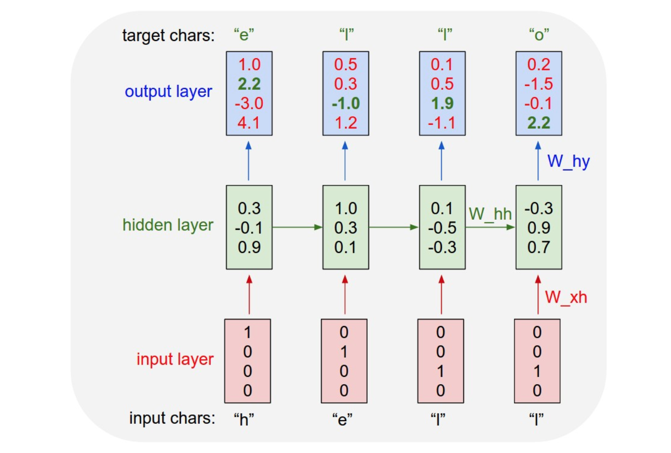
Character Level Language Model
A Vocabulary of four possible letters are ‘HELO’
The probability of “e” should be likely given the context of “h”
“l” should be likely in the context of “he”
“l” should also be likely given the context of “hel”
“o” should be likely given the context of “hell”.

Slide 46
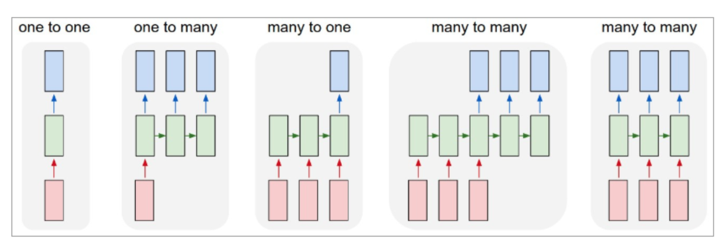
A Few Examples of Neural Network

Slide 47
Character Level Language Model
we will encode each character into a vector using 1-of-k encoding (i.e. all zero except for a single one at the index of the character in the vocabulary)
Feed them into the RNN one at a time with the step function. We will then observe a sequence of 4-dimensional output vectors
When the RNN saw the character “h” it assigned confidence of 1.0 to the next letter being “h”, 2.2 to letter “e”, -3.0 to “l”, and 4.1 to “o”
We would like to increase its confidence (green) and decrease the confidence of all other letters (red)
we can run the backpropagation algorithm to figure out in what direction we should adjust every one of its weights to increase the scores of the correct targets (green bold numbers)

Slide 48
Vanishing Gradients
RNN’s suffer from short-term memory, so how do we combat that?
Now when we do Back-propagation i.e moving backward in the Network and calculating gradients of loss(Error) with respect to the weights , the gradients tends to get smaller and smaller as we keep on moving backward in the Network. This means that the neurons in the Earlier layers learn very slowly as compared to the neurons in the later layers in the Hierarchy. The Earlier layers in the network are slowest to train
Why Earlier layers of the Network are so important to us?
Earlier layers in the Network are important because they are responsible to learn and detecting the simple patterns and are actually the building blocks of our Network. Obviously , if they give improper and inaccurate results , then how can we expect the next layers and the complete Network to perform nicely and produce accurate results.

Slide 49
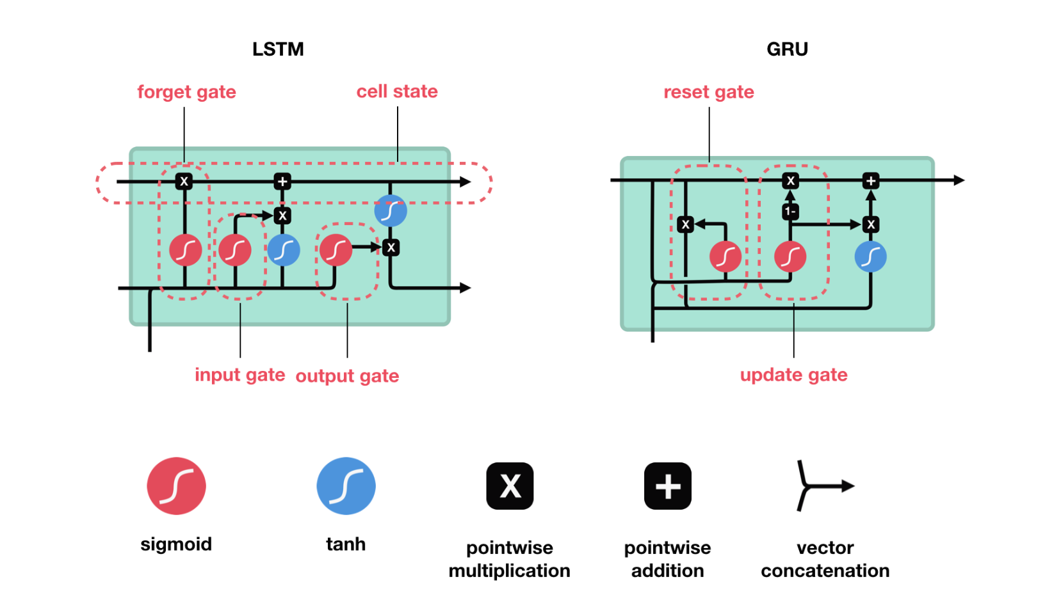
LSTM and GRU
LSTM and GRU’s essentially function just like RNN’s, but they’re capable of learning long-term dependencies using mechanisms called “gates.”
1)Long Short-Term Memory
2)Gated Recurrent Units or GRU’s

Slide 50
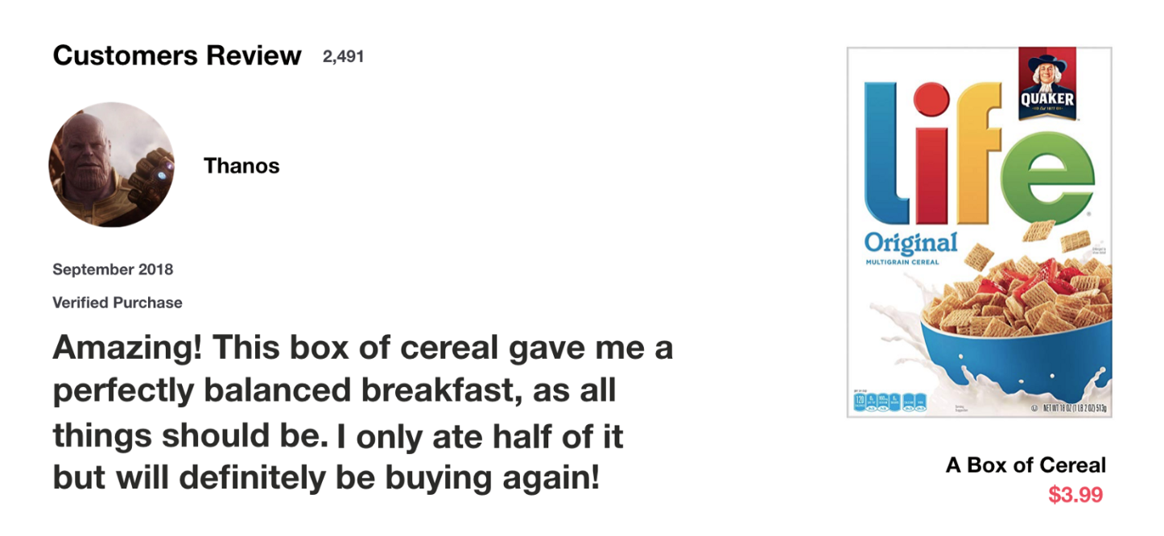
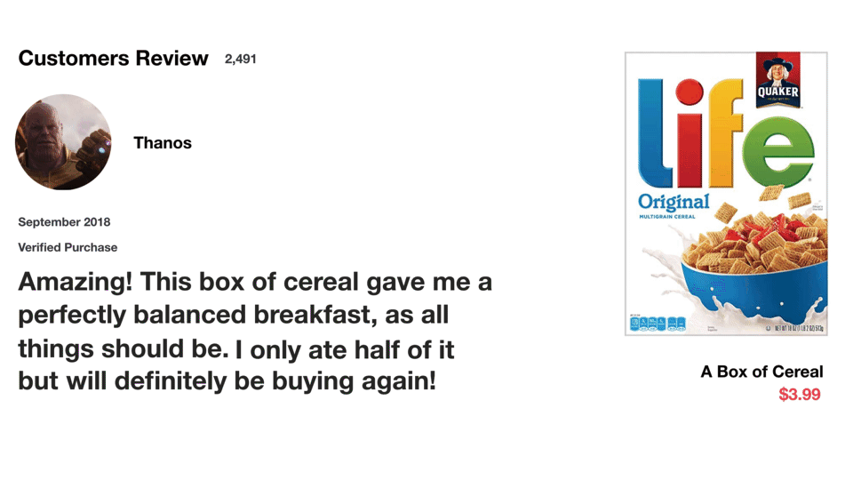
LSTM

Slide 51
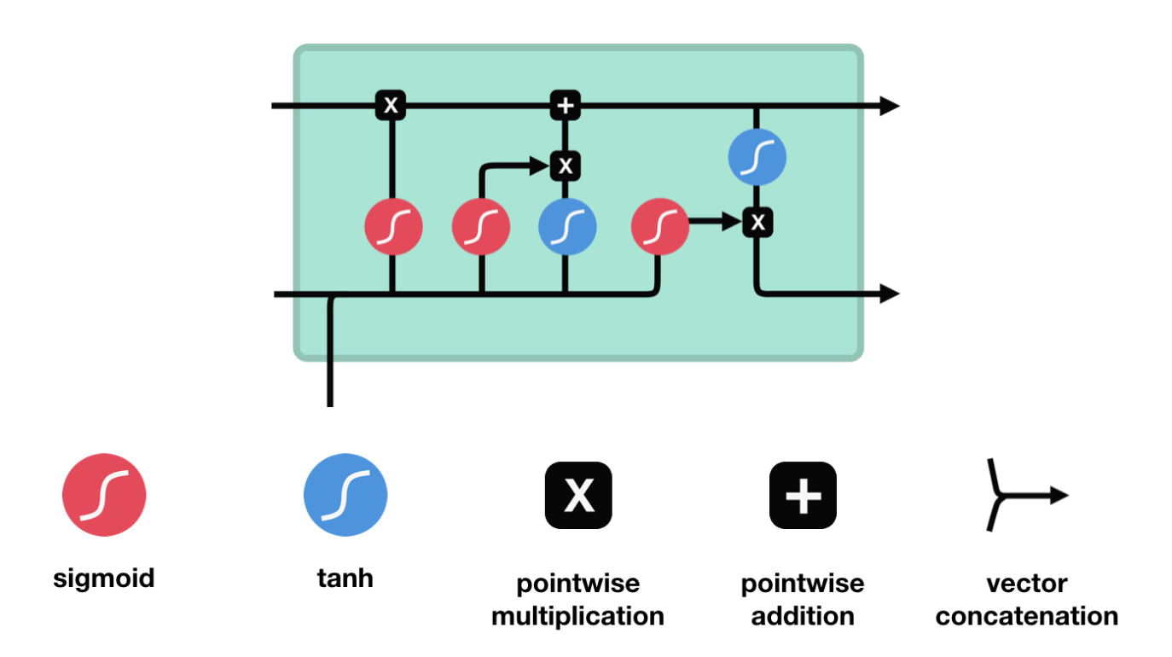
LSTM
An LSTM has a similar control flow as a recurrent neural network. It processes data passing on information as it propagates forward. The differences are the operations within the LSTM’s cells.

Slide 52
LSTM
The cell state, in theory, can carry relevant information throughout the processing of the sequence
Information from the earlier time steps can make it’s way to later time steps
As the cell state goes on its journey, information get’s added or removed to the cell state via gates
The gates are different neural networks that decide which information is allowed on the cell state
The gates can learn what information is relevant to keep or forget during training

Slide 53
LSTM - Sigmoid
A sigmoid activation is similar to the tanh activation. Instead of squishing values between -1 and 1, it squishes values between 0 and 1
That is helpful to update or forget data because any number getting multiplied by 0 is 0, causing values to disappears or be “forgotten.”
Any number multiplied by 1 is the same value therefore that value stays the same or is “kept.
The network can learn which data is not important therefore can be forgotten or which data is important to keep

Slide 54
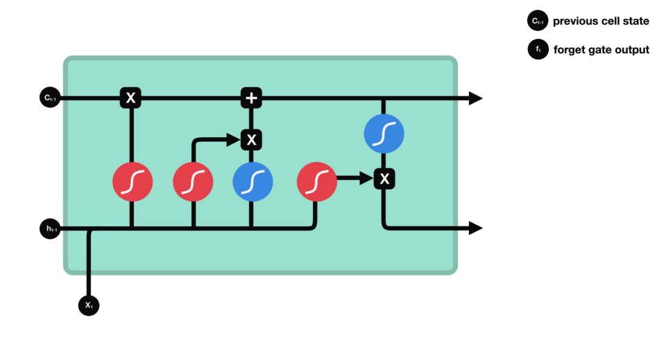
LSTM - Forget Gate
This gate decides what information should be thrown away or kept
Information from the previous hidden state and information from the current input is passed through the sigmoid function. Values come out between 0 and 1
The closer to 0 means to forget, and the closer to 1 means to keep.

Slide 55
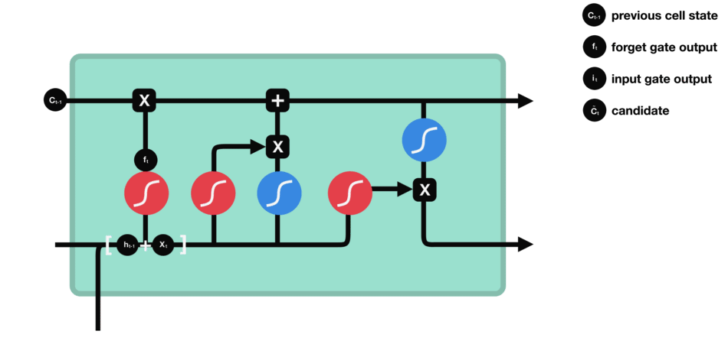
LSTM - Input Gate
First, we pass the previous hidden state and current input into a sigmoid function
That decides which values will be updated by transforming the values to be between 0 and 1. 0

Slide 56
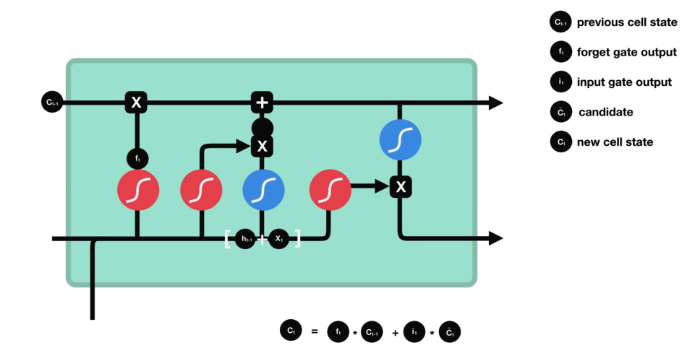
LSTM - Cell State
First, the cell state gets pointwise multiplied by the forget vector.
This has a possibility of dropping values in the cell state if it gets multiplied by values near 0
Then we take the output from the input gate and do a pointwise addition which updates the cell state to new values that the neural network finds relevant.

Slide 57

LSTM - Output Gate
The output gate decides what the next hidden state should be. Remember that the hidden state contains information on previous inputs.
The hidden state is also used for predictions

Slide 58
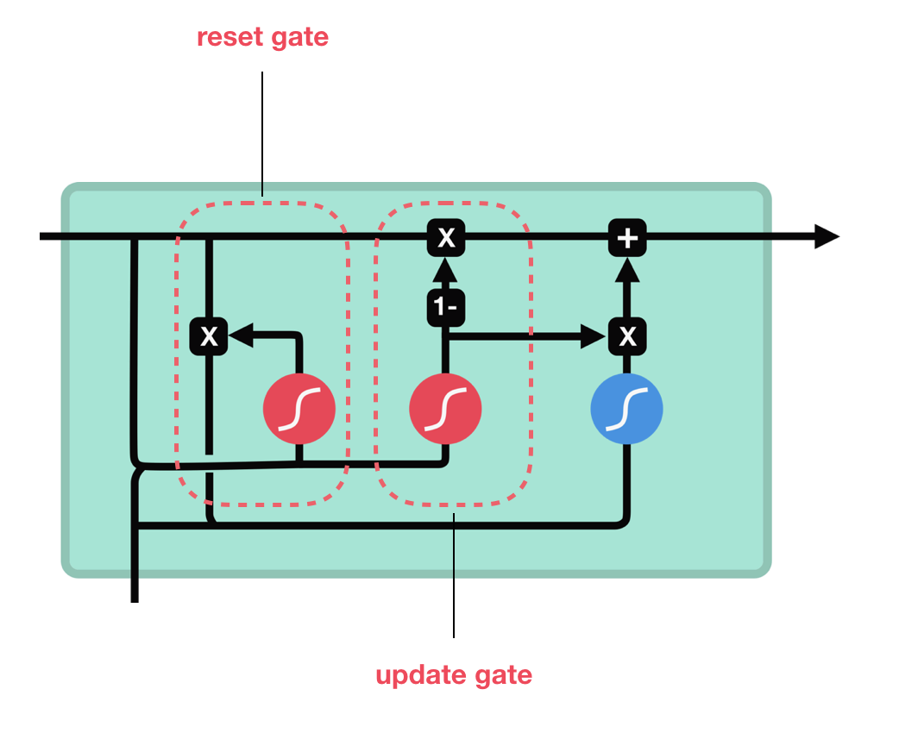
GRU - Gated Recurrent Unit
The update gate acts similar to the forget and input gate of an LSTM. It decides what information to throw away and what new information to add.
The reset gate is another gate is used to decide how much past information to forget.
GRU’s has fewer tensor operations; therefore, they are a little speedier to train then LSTM’s

Slide 59
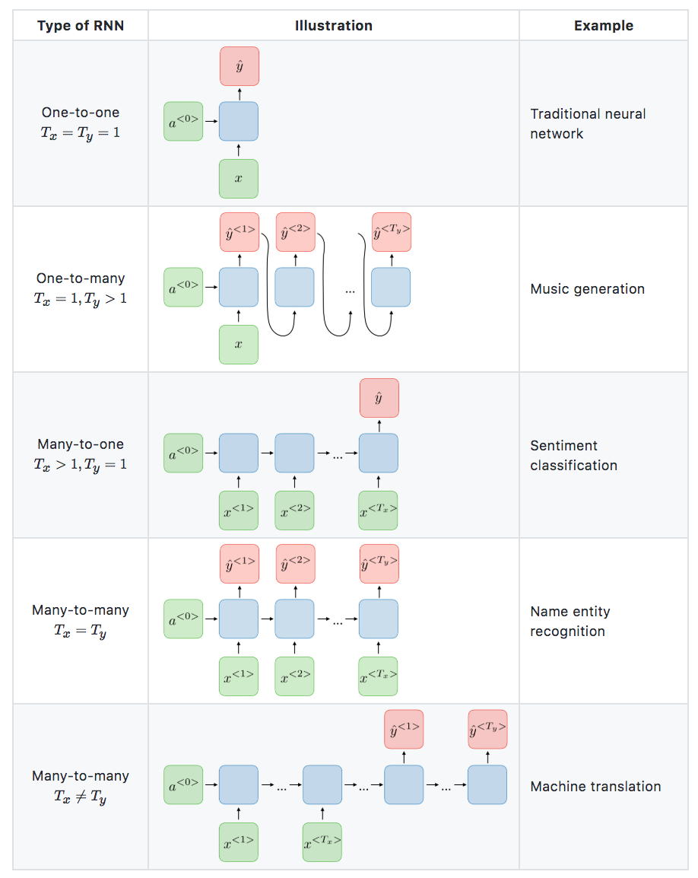
Applications of RNN’s

Slide 60

Attention Model
This model allows an RNN to pay attention to specific parts of the input that is considered as being important, which improves the performance of the resulting model in practice

Slide 61
RNN - Reference
https://towardsdatascience.com/illustrated-guide-to-lstms-and-gru-s-a-step-by-step-explanation-44e9eb85bf21
https://towardsdatascience.com/illustrated-guide-to-recurrent-neural-networks-79e5eb8049c9
https://www.quora.com/How-is-the-hidden-state-h-different-from-the-memory-c-in-an-LSTM-cell
https://www.youtube.com/watch?v=5Vl-bK7tfD8&list=PLBAGcD3siRDittPwQDGIIAWkjz-RucAc7

